Slide 1
MS2 as a Surrogate Assay

Slide 2
Three experiments:
Effects of RT
Effects of untreated saliva
Standard Curve
Heat template at 95°C for 5 min
45°C for 5 min
95°C for 3 min
50 cycles
95°C for 1 sec
60°C for 10 sec

Slide 3
RT
Template conc: 10⁴ pfu/rxn
Primer conc: 0.9 uM
Probe conc: 0.25 uM
3 samples:
Add RT (positive control)
Do not add RT
Add RT but do not heat template

Slide 4
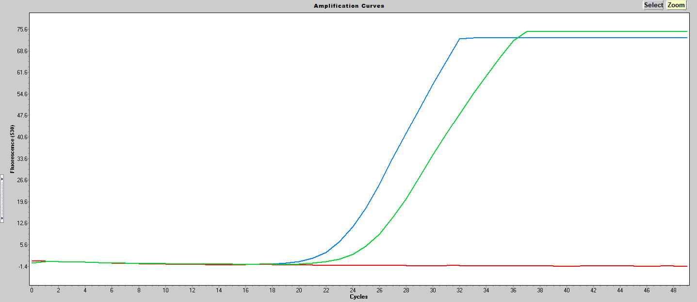
RT Analysis
The +/- RT samples behaved as expected with the +RT showing a strong signal and
–RT not amplifying.
The sample without heating the template also shows a strong signal but has a higher cp suggesting that there is a mix of packaged and unpackaged RNA in the template.
+RT (23.14)
Packaged RNA (no heat) (25.16)
- RT

Slide 5
Saliva
Template conc: 10³ pfu/rxn
Primer conc: 0.9 uM
Probe conc: 0.125 uM
Add saliva to unpackaged RNA (heat template)
Add saliva to packaged RNA (do not heat template)
Positive Control (no saliva)
No RT
After combining saliva and template it was incubated at 37°C for 10 min then heat treated at 95°C for 10 min.

Slide 6
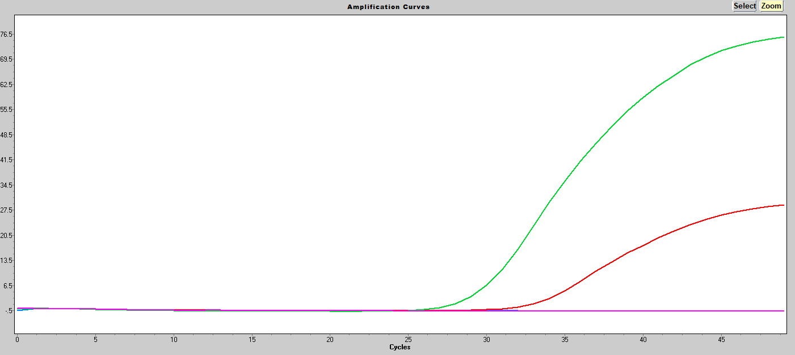
Saliva Analysis
Positive Control (29.47)
The saliva completely killed the rxn when added to unpackaged RNA but only partially killed it when added to packaged RNA.
Packaged RNA w/ saliva (33.13)
Unpackaged RNA w/ saliva
-RT

Slide 7
Standard Curve
10⁵, 10⁴, and 10³, pfu/rxn
Primer concentration: 0.9 uM
Probe concentration: 0.25 uM

Slide 8
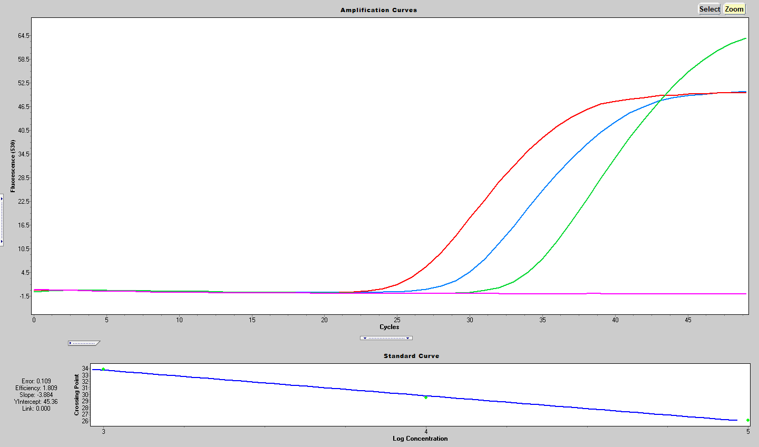
Standard Curve Analysis
Efficiency = -1+10^{(-1/slope)}
=1.809
1x10⁵ (26.07)
1x10⁴ (29.56)
1x10³ (33.84)
NTC

